Slide 1
KNN Classification on High Redshift Quasars
By Limeng Jiang

Slide 2
Sections
Project Goals
Training
Testing
Comparison
Remarks

Slide 3
Project Goals
Find a smooth boundary with KNN which will perform better than classical cuts, or which will act as a supplement to classical cuts
Apply the trained filters (for i and z dropout) to larger and larger test catalogs, and we can conclude that 1) the KNN classification works best in what ranges and 2) to which scope we can apply those trained filters.

Slide 4
KNN (K-Nearest Neighbors Algorithm)
Supervised learning classifier
Work off the assumption that similar points can be found near one another.
The goal of the k-nearest neighbor algorithm is to identify the nearest neighbors of a given query point, so that we can assign a class label to that point
computationally demanding, challenging to interpret <=> find very complex patterns

Slide 5
Training
Data & Preprocessing
Feature Selection
Hyperparameters
Performance

Slide 6
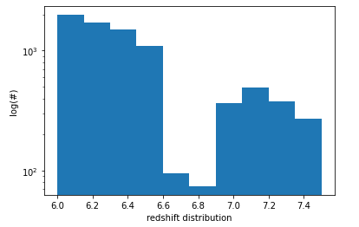
Data & Preprocessing
Platform: Astro DataLab (Python)
Training Datasets:
Each catalog has similar distributions (with different peaks) across i and z bands and across Y, J, H, F bands
Catalogs across categories share similar distributions (peaks and tails) in z band
Select i, z, Y, J, H, F bands
Dataset size: around 23k, 7.8k of them are quasars

Slide 7
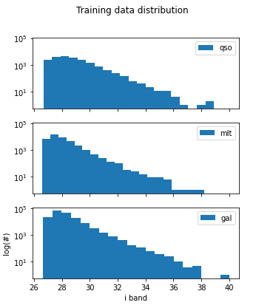
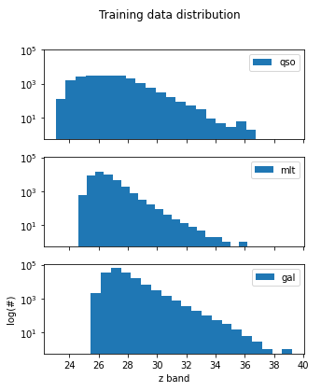
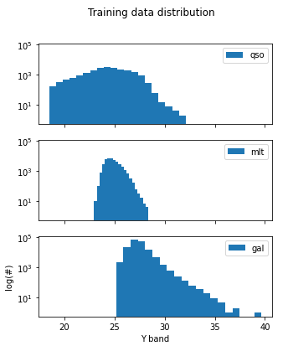
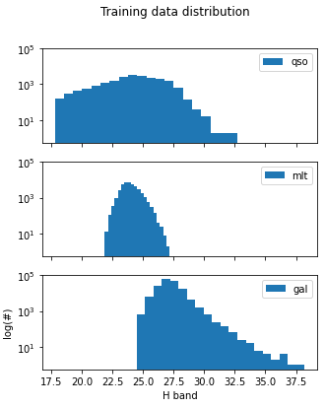

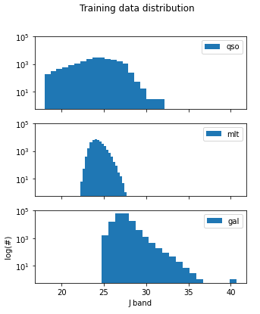

Slide 8
Data & Preprocessing
Preprocessing:
snr(r) < 5
snr(i) < 5
24 < z < 26
Redshift < 7.5
Dropped 99.99 values
Select i, z, Y, J, H, F bands

Slide 9
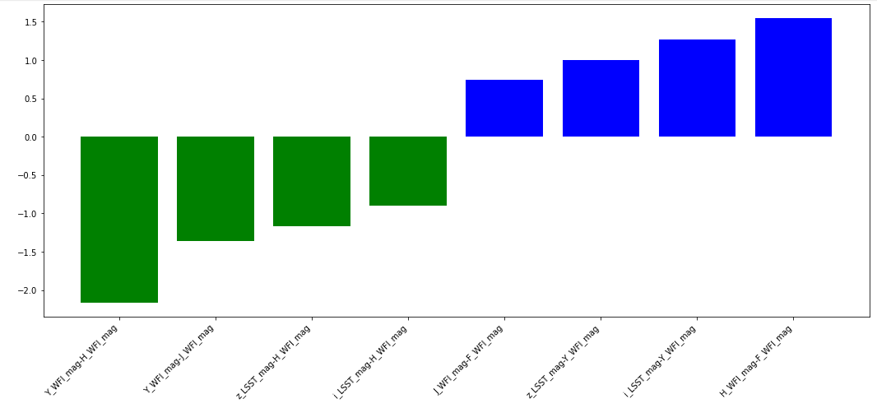
Feature Selection
Use Linear SVC to select the top 8 most influential features out of all available colors coming out of i, z, Y, J, H, F
Now we have [Y - H, H-F, i-Y, Y-J, z-H, z-Y, i-H, J-F] to proceed.
Then start training KNN based on any two combinations of the above colors.
Notes:
Reason for feature selection: too many colors, want to select the most “useful”, most contributing ones
Why linear SVM: Easier to interpret. In a linear SVM, the coefficients (weights) assigned to each feature determine their importance. Features with larger absolute coefficient values contribute more to the decision boundary.

Slide 10
Hyperparameters for KNN
n_neighbors: number of neighbors to use by default for kneighbors queries
leaf_size: affects speed and memory used for training
weights: Weight function used in prediction, {‘uniform’, ‘distance’}
metric: the distance metric which decides which points are closest to a given query point, {'minkowski', 'euclidean', 'manhattan'}
p: decides the metric. p=1: manhattan; p=2: euclidean; other p: minkowski (l_p)
algorithm: Algorithm used to compute the nearest neighbors, {‘auto’, ‘ball_tree’, ‘kd_tree’, ‘brute’}
Notes:
N_neighbors: k-> regularization param, selected by cv; smaller the k is, more flexible (and more varying) the boundary is
Weights: ‘uniform’ : uniform weights. All points in each neighborhood are weighted equally.
‘distance’ : weight points by the inverse of their distance. in this case, closer neighbors of a query point will have a greater influence than neighbors which are further away.
[callable] : a user-defined function which accepts an array of distances, and returns an array of the same shape containing the weights.
regularization param, selected by cv; smaller the k is, more flexible (and more varying) the boundary is
weights:
‘uniform’ : uniform weights. All points in each neighborhood are weighted equally.
‘distance’ : weight points by the inverse of their distance. in this case, closer neighbors of a query point will have a greater influence than neighbors which are further away.

Slide 11
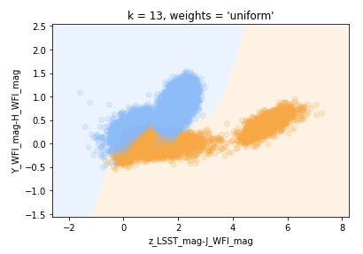
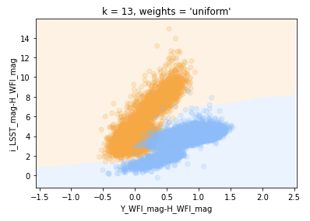
Performance (Individual Filters)
Best score: avg of r2 scores (total variance explained by model / total variance)
Precision: TP/(TP+FP)
Recall: TP/(TP+FN)
Training best score: 0.9882
Training precision: 0.9826
Training recall: 0.9831
Training best score: 0.9938
Training precision: 0.9894
Training recall: 0.991
Notes:
Best score: the average of r2 scores (total variance explained by model / total variance) on left-out test folds for the best parameter combination. The best scores are designed to evaluate the optimization of hyperparameters during the training, so it reflects the overall performance of the models.
Note that they use 0/1 labels for predictions
Precision: TP/(TP+FP)
Recall: TP/(TP+FN)

Slide 12
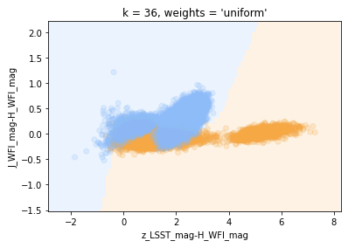
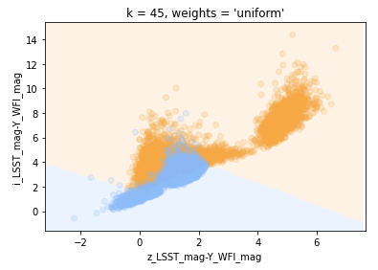
Performance (Individual Filters)
Training best score: 0.9463
Training precision: 0.9132
Training recall: 0.9236
Training best score: 0.9678
Training precision: 0.9543
Training recall: 0.9494
Notes:
Best score: the average of r2 scores (total variance explained by model / total variance) on left-out test folds for the best parameter combination. The best scores are designed to evaluate the optimization of hyperparameters during the training, so it reflects the overall performance of the models.

Slide 13
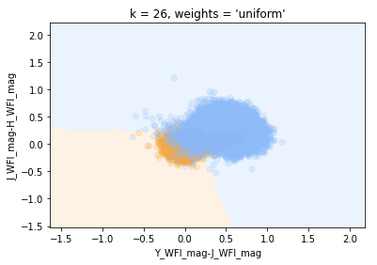
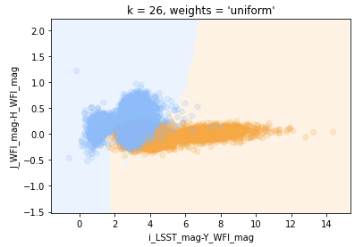
Performance (Individual Filters)
Training best score: 0.95
Training precision: 0.9122
Training recall: 0.9039
Training best score: 0.9161
Training precision: 0.8998
Training recall: 0.8624
Notes:
Best score: the average of r2 scores (total variance explained by model / total variance) on left-out test folds for the best parameter combination. The best scores are designed to evaluate the optimization of hyperparameters during the training, so it reflects the overall performance of the models.

Slide 14
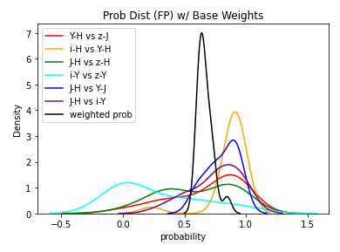
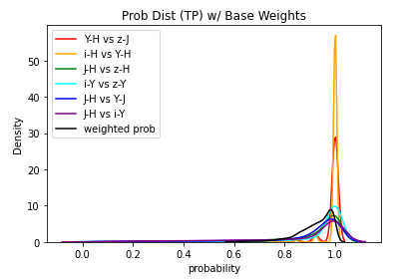
Performance (weighted classifier)
The weighted classifier is a joint of the above 6 classifiers, each with probability prediction, and calculate a weighted probability with a threshold=0.6, so those with weighted probability > 0.6 will be classified as quasars (how I get threshold=0.6: comparison of weighted prob)
Base weights: use the training best scores as weights
Training Precision: 0.9976
Training Recall: 0.9823

Slide 15
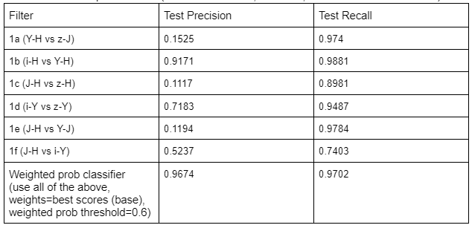
Performance (a follow-up test)
Test Dataset:
qso_test + mlt_test + gal_test_patch
Each catalog has similar distributions (with different peaks) across i and z bands and across Y, J, H, F bands
The same data selection criteria as the training dataset
Size around 30k
Notes:
Corresponds to notebook decision_boundary_z_check_performance.ipynb
Test dataset: keeps all the features of the training datasets, both quasars and contaminants

Slide 16
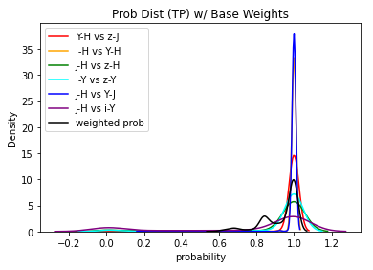
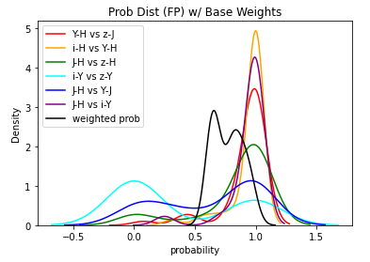
Performance (a follow-up test)
For the weighted classifier, its probability distributions of test prediction results are as follows:
The dominance of some of the filters change (like J-H vs Y-J) compared with the training.
Notes:
We move on with the weighted classifier

Slide 17
Testing
Test 1 (keep z-band cut)
Test 2 (remove z-band cut)
Test 3 (remove remaining constraints; now apply J <= 25.5)

Slide 18

Test 1 (keep z-band cut)
Test Dataset:
qso_test + mlt_test + gal_test_patch
Each catalog has similar distributions (with different peaks) across i and z bands and across Y, J, H, F bands
Remove all the snr, redshift, and drop 99.99 constraints
Keep the z-band cut: test dataset size around 18k (2407 of them are quasars)
Performance: precision & recall
Notes:
Corresponds to notebook decision_boundary_z_max26.ipynb
See with the same test catalog as the followup test but with fewer constraints (i.e.) larger scope, how will the filters perform

Slide 19
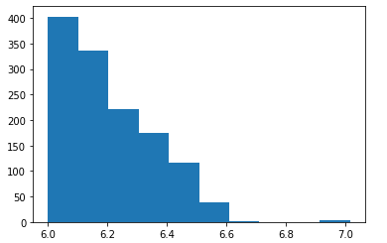
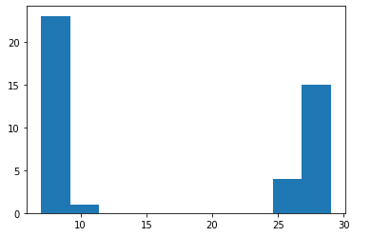
Test 1 (keep z-band cut)
Performance:
redshift distribution of TP
Performance:
spectral type distribution of TP (0: galaxies; other: mlt)
num
num
redshift
spt

Slide 20
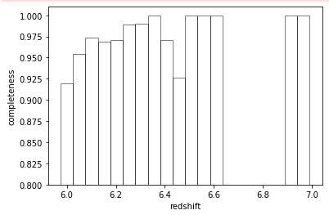
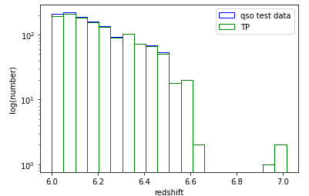
Test 1 (keep z-band cut)
Performance: completeness
Notes:
Basically the filters perform well in the range redshift~ 6.3 and above

Slide 21

Test 2 (remove z-band cut)
Test Dataset:
qso_test: the catalog that has the same form of distribution across bands
Pq_bmc: a large catalog that has a similar form of distribution to that of qso_test
Removes the z-band cut, snr and redshift constraints; uses a new contaminants catalog (Pq_bmc)
After removing the z-band cut: test dataset size around 41k (4270 of them are quasars)
Performance: precision & recall
Notes:
Corresponds to z_pipeline_test_small.ipynb

Slide 22
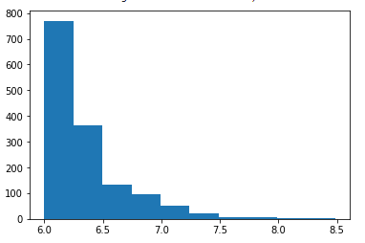
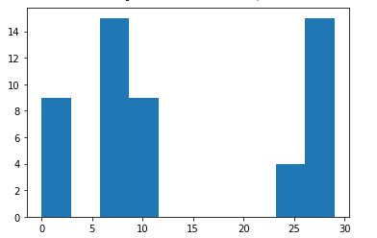
Test 2 (remove z-band cut)
Performance: redshift distribution of TP
Performance: spectral type distribution of TP (0: galaxies; other: mlt)
Notes:
Go on and see how the knn filters extend to other regimes

Slide 23
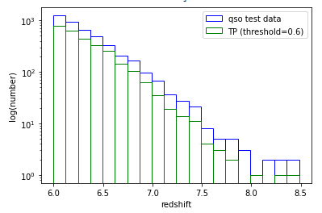
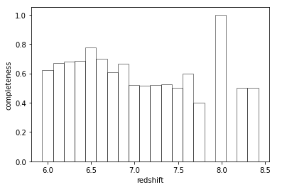
Test 2 (remove z-band cut)
Performance: completeness

Slide 24
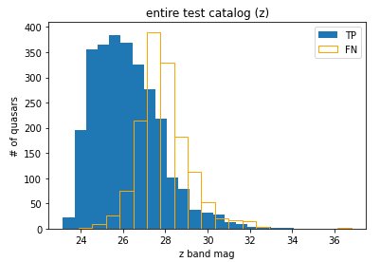
Test 2 (remove z-band cut)
Performance: which part the z pipeline is missing
Notes:
The pipeline works well with the region z < 24
Misses a lot of the quasars which fall in the region z >= 26 (makes sense because the pipeline is not trained for that region)
Has some capability of extending to a broader scope

Slide 25
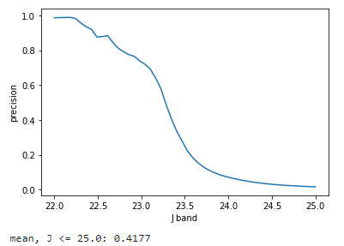
Test 3 (remove remaining constraints; now apply J <= 25.5)
Test Datasets:
Pq_bmc: a catalog that has similar form of distribution across bands; use the qso and gal catalogs
mlt_test_catalog_xr: approximately the same form of distribution across bands; has a smaller coverage of bands than test qso but a larger coverage than test galaxies; wider coverage than the test mlt in Pq_bmc
After removing all other constraints and apply J <= 25.5: test dataset size around 2.2M (2150 of them are quasars)
Performance: precision & recall
Precision: 0.0122; Recall: 0.9647
If limit z < 26: precision: 0.3467; recall: 0.9952
Notes:
No redshift info available for these test catalogs
Corresponds to z_pipeline_test_new.ipynb

Slide 26
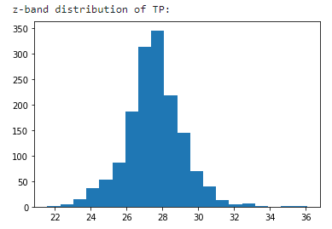
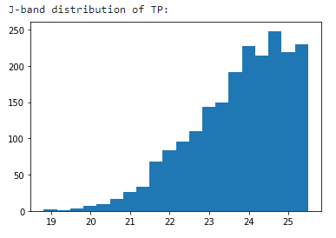
Test 3 (remove remaining constraints; now apply J <= 25.5)
Performance: TP distribution

Slide 27
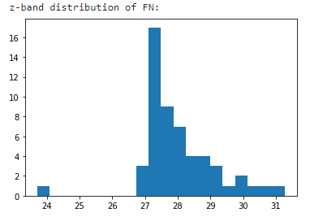
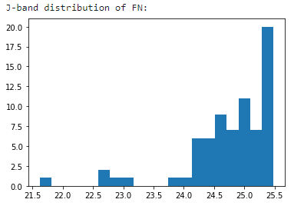
Test 3 (remove remaining constraints; now apply J <= 25.5)
Performance: FN distribution
Notes:
The knn classifier

Slide 28
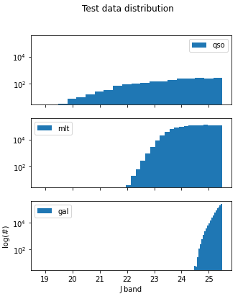
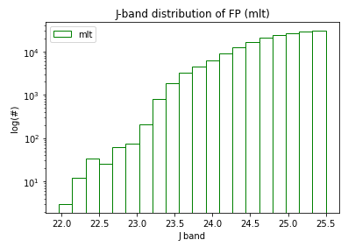
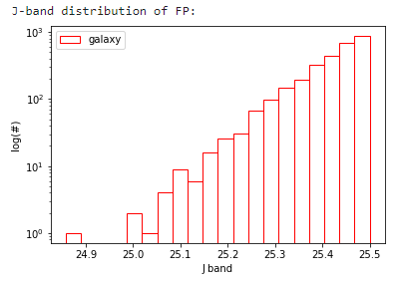
Test 3 (remove remaining constraints; now apply J <= 25.5)
Performance: FP distribution
…Uniformly mis-classifying the mlt and galaxies across their distribution.

Slide 29
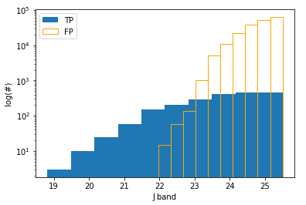
Test 3 (remove remaining constraints; now apply J <= 25.5)
Why there are so many FP, except for the reason that it’s far beyond the training scope

Slide 30
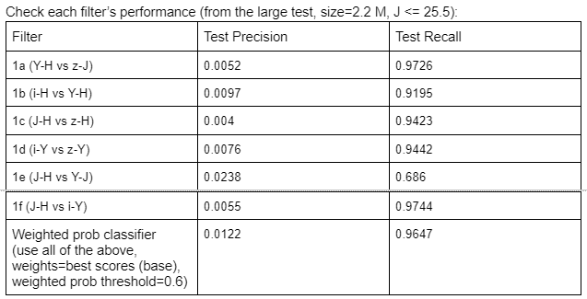
Test 3 (remove remaining constraints; now apply J <= 25.5)
Reminder of the filters we have & how they perform now

Slide 31
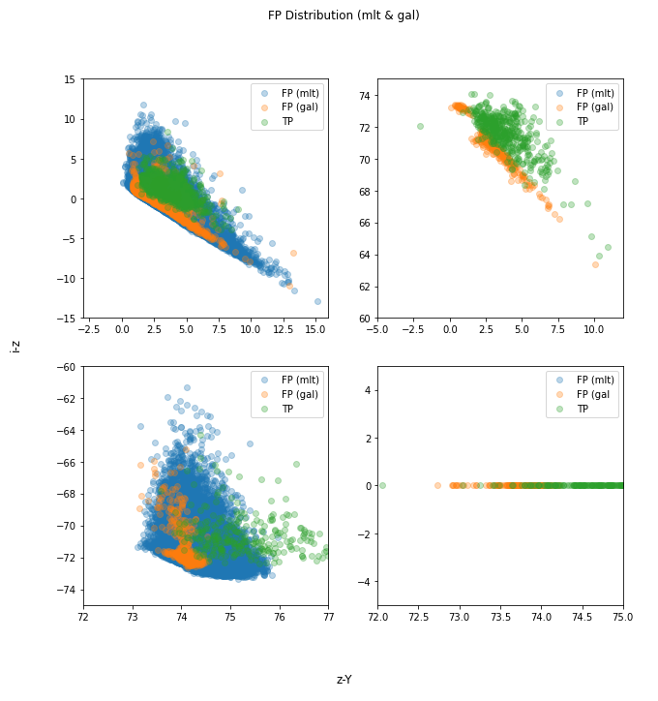
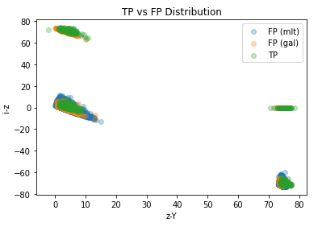
Test 3 (remove remaining constraints; now apply J <= 25.5)
Examine the color plots
Possible cause: didn’t include 99.99 values in the training
Notes:
NOT among the filters’ choice of colors

Slide 32
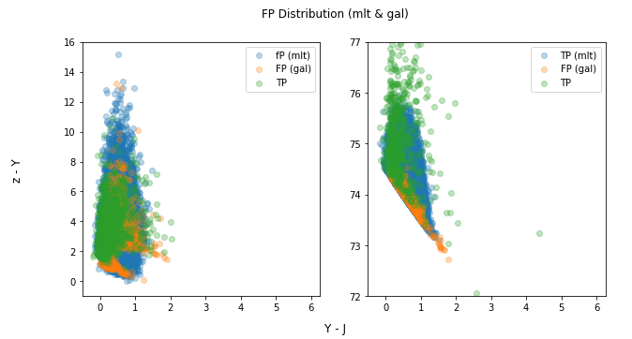
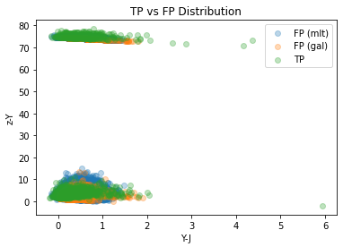
Test 3 (remove remaining constraints; now apply J <= 25.5)
Notes:
NOT among the filters’ choice of colors

Slide 33
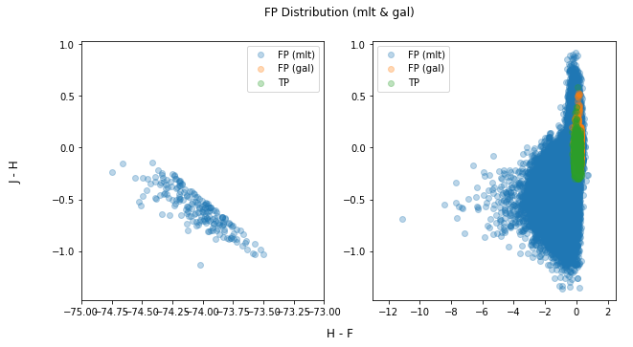
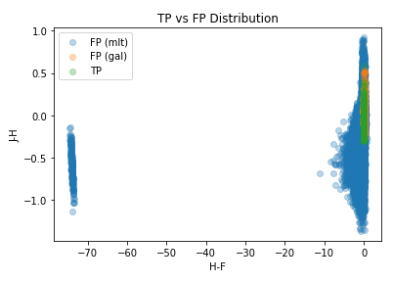
Test 3 (remove remaining constraints; now apply J <= 25.5)
Possible causes: didn’t include 99.99 values in the training & the color H-F doesn’t come into any of the filter, so the weighted classifier is unable to capture its range
Notes:
NOT among the filters’ choice of colors

Slide 34
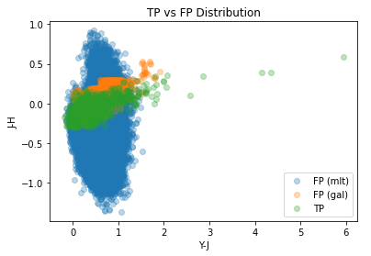
Test 3 (remove remaining constraints; now apply J <= 25.5)
Possible cause: it is a weighted classifier which has 6 components (individual filters), so ‘bad’ performance of some of the filters impacts that of the other filters
Notes:
IS among the filters

Slide 35
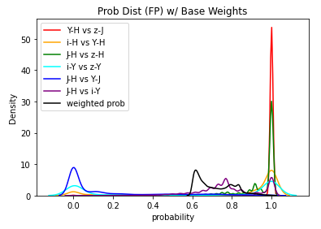
Test 3 (remove remaining constraints; now apply J <= 25.5)
Possible solutions:
Adjust weights
Do a second round of classification solely with J-H vs Y-J

Slide 36
Comparison
Comparison between classical cuts and KNN

Slide 37

Comparison
Test dataset: pq_bmc
Selection criteria: remove z-band cut and apply J <= 25.0
Performance: precision & recall

Slide 38
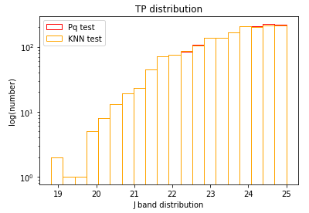
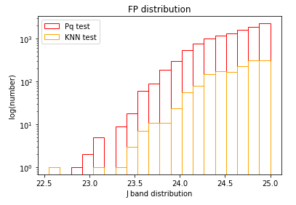
Comparison
Performance: TP distribution
Performance: FP distribution

Slide 39
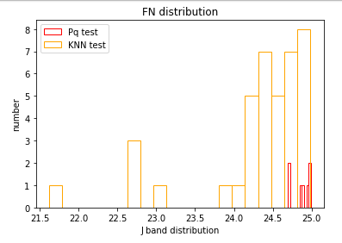
Comparison
Performance: FN distribution

Slide 40
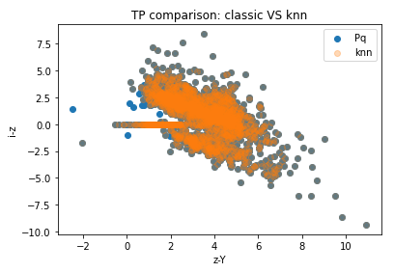
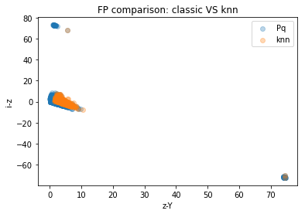

Comparison
Color diagrams: TP vs FP vs FN

Slide 41



Comparison
Color diagrams: TP vs FP vs FN

Slide 42



Comparison
Color diagrams: TP vs FP vs FN

Slide 43



Comparison
Color diagrams: TP vs FP vs FN

Slide 44
Remarks

Slide 45
There is an i-pipeline trained, too. It has a low recall rate and misses most of the quasars near z ~ 6.0. See document: knn i pipeline
The choice of weights still needs more consideration.

Slide 46
Thank You!

